Slide 1

MINOR PROJECT
Street Light Monitoring System using IOT
Electronics and Communication Engineering
Presented By :-
Guided By :-
Dr. Mahendra Singh Thakur
Prof. Pankaj Raghuwanshi
Raj Yadav
Sandhya Kashyap
Salma Bano
Shraddha Shrivansh
Sem / Year :- 6th / 3rd

Slide 2

Introduction
Components required
Street light monitoring system using IOT
Basics of Microcontroller
Protocol, Cloud and App
Schematics diagram
Circuit diagram
Working
Smart street light circuit diagram and working system using IOT (video content)
Advantages and Disadvantages of street light monitoring system using IoT
Street light automation in Bhopal city

Slide 3


Automatic street light which can sense the daytime and night time, and automatically turns on and off accordingly the night and day. Here we are extending this project by adding one more constraint to turn on the light that is Street light will only glow if there is darkness and someone is passing through the street. control the LEDs (Street lights) over the internet from anywhere in the world.

Slide 4
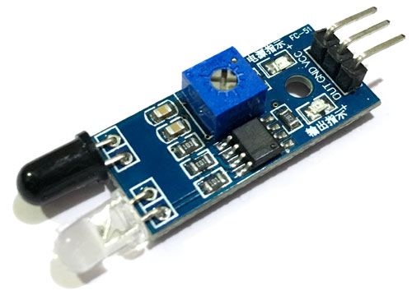
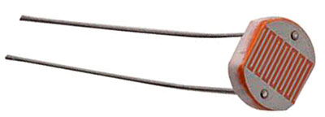
Components Required :-
ESP8266 NodeMCU
Micro USB cable
LEDs
Jumper wires
IR sensors
LDR sensors
Registers
IR sensors
LDR sensors

Slide 5
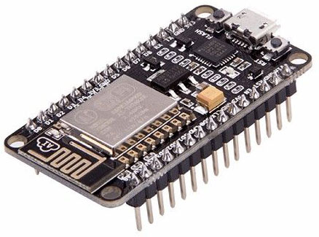
Role Of Microcontroller
NodeMCU ESP8266 is a low-cost Wi-Fi enabled microcontroller board that can be used to connect devices to the internet of things (IoT) network.
In the Smart Street Light monitoring system, NodeMCU ESP8266 can be used to collect and transmit data from the street lights to the central monitoring system.
The NodeMCU ESP8266 can be connected to various sensors, such as light sensors and motion or IR sensors, which can detect when a street light needs to be turned on or off.
The NodeMCU can then send this information to the central monitoring system, which can be used to automatically control the street lights.
In addition, the NodeMCU ESP8266 can also be used to monitor the energy consumption of the street lights.
which can be used to optimize their operation and reduce energy costs.
ESP8266 NodeMCU

Slide 6
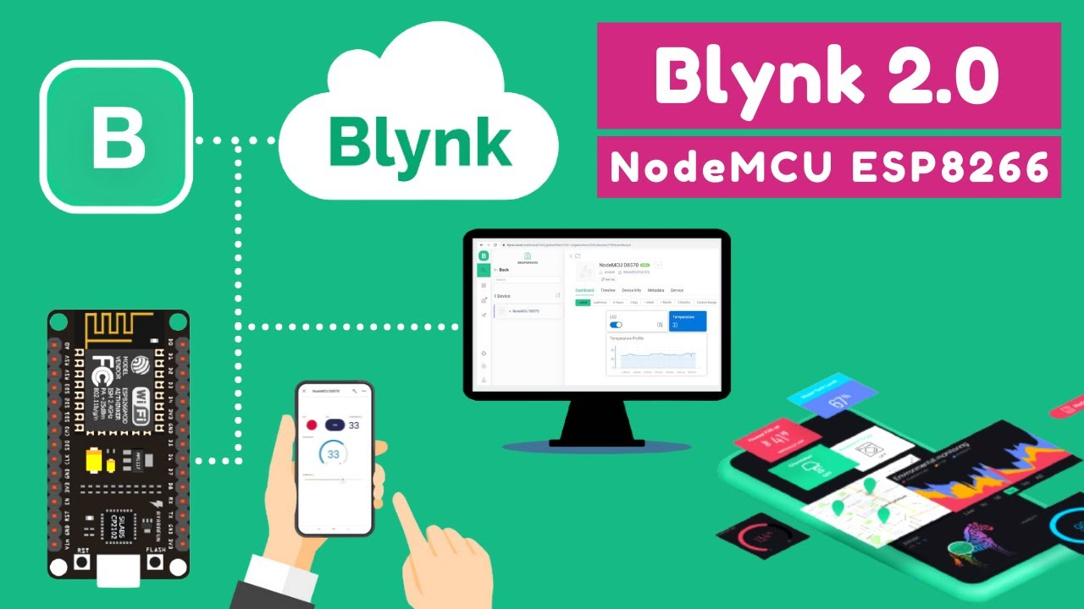
Data On Blynk App To Cloud And Protocols
Blynk is a mobile application platform that can be used to control and monitor IoT devices.
It can help to increase the efficiency and effectiveness of the system, reduce energy consumption, and improve public safety.
Some of the key functions of the Blynk app
Remote control of street lights
Real-time monitoring of the status of street lights
Custom alerts and notifications for specific events
Access to the central monitoring system of the Smart Street Light system
Analytics and reporting for data-driven decision making

Slide 7
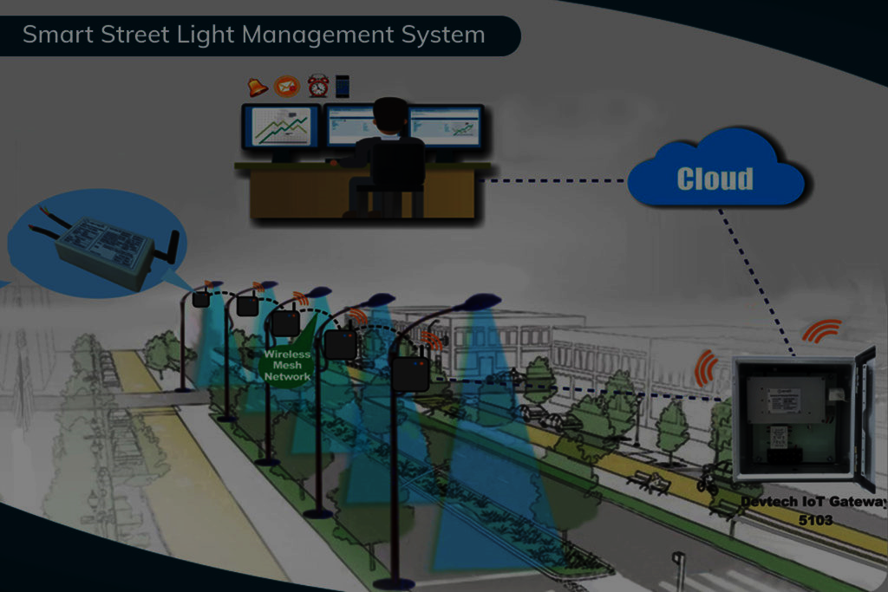
Street Light Monitoring System using IOT
There are several ways in which IoT can be used in a Smart Street Light monitoring system, including:
Energy efficiency :- IoT-enabled street lights can be equipped with sensors that detect ambient light levels, as well as motion sensors that detect when people or vehicles are nearby. This enables the street lights to automatically adjust their brightness and turn on or off as needed, reducing energy consumption and costs.
Real-time monitoring :- IoT-enabled sensors can collect data on the status of individual street lights, as well as environmental factors such as temperature and humidity. This data can be transmitted to a central monitoring system in real-time, allowing administrators to quickly detect and respond to any issues or faults in the system.
Predictive maintenance :- By analyzing data from IoT-enabled sensors, administrators can predict when street lights will need maintenance or replacement, enabling them to schedule maintenance proactively and avoid downtime.
Enhanced safety and security :- IoT-enabled street lights can be equipped with cameras and other sensors that can detect suspicious activity, alerting authorities and increasing public safety.

Slide 8
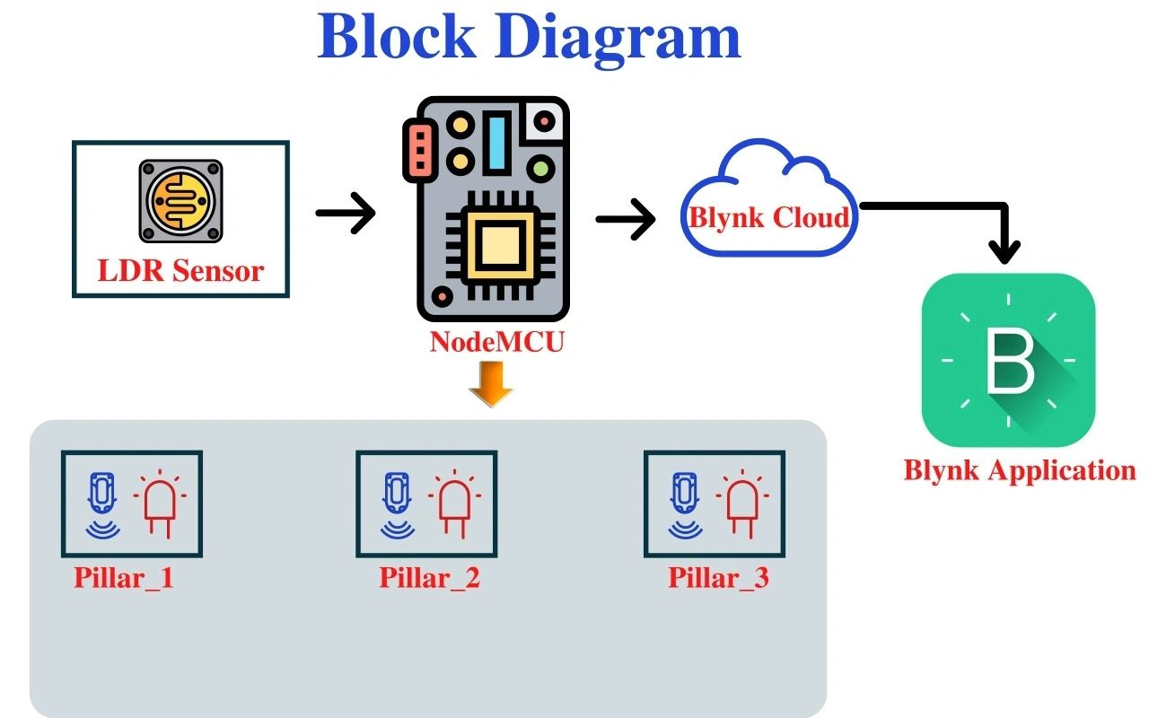
Schematic Diagram:-

Slide 9
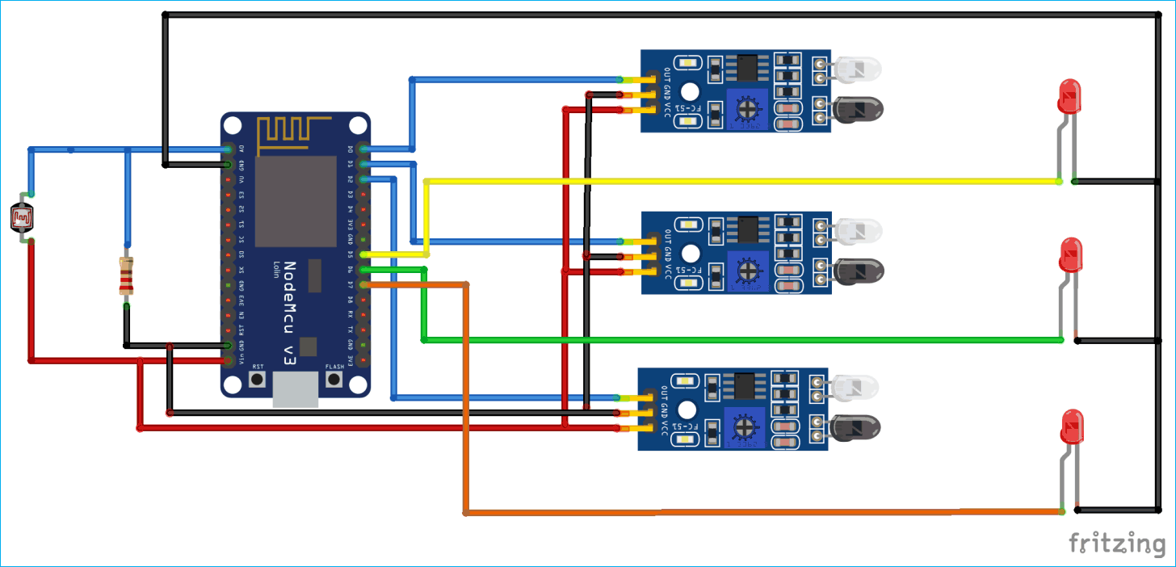
Circuit Diagram :-

Slide 10
LDR sensor is used to detect whether it is daytime or night time.
LDR sensor generates variable resistance based on the amount of light falling on it.
IR sensors are used to detect if someone is crossing the street or not. It detects the obstacle or motion in the surrounding. The transmitter will transmit IR rays which will be reflected back if it falls on some object like person, animal, vehicles, etc.
The reflected ray will be received by receiver diode and hence will confirm the presence of object and the corresponding LED will be glowed.
The LDR sensor, IR sensors and leds data on the Blynk app.

Slide 11


With the help of IOT, street lights can switch ON and OFF automatically.
Maintenance of street lights using IOT is quite less which leads to cost reduction.
Street lights using IOT will also reduce light pollution.
Power consumption is quite low in these street lights using IoT which also leads to energy conservation.
No large manpower is required to maintain these street lights using IoT.

Slide 12


Existing Street Light Systems Are Needed To Be Switched ON And OFF Manually.
Existing Street Light System Has A High Power Consumption And Their Maintenance Is Also Quite Expensive.
More Manpower Is Required To Handle The Functioning Of The Existing Street Light System.

Slide 13
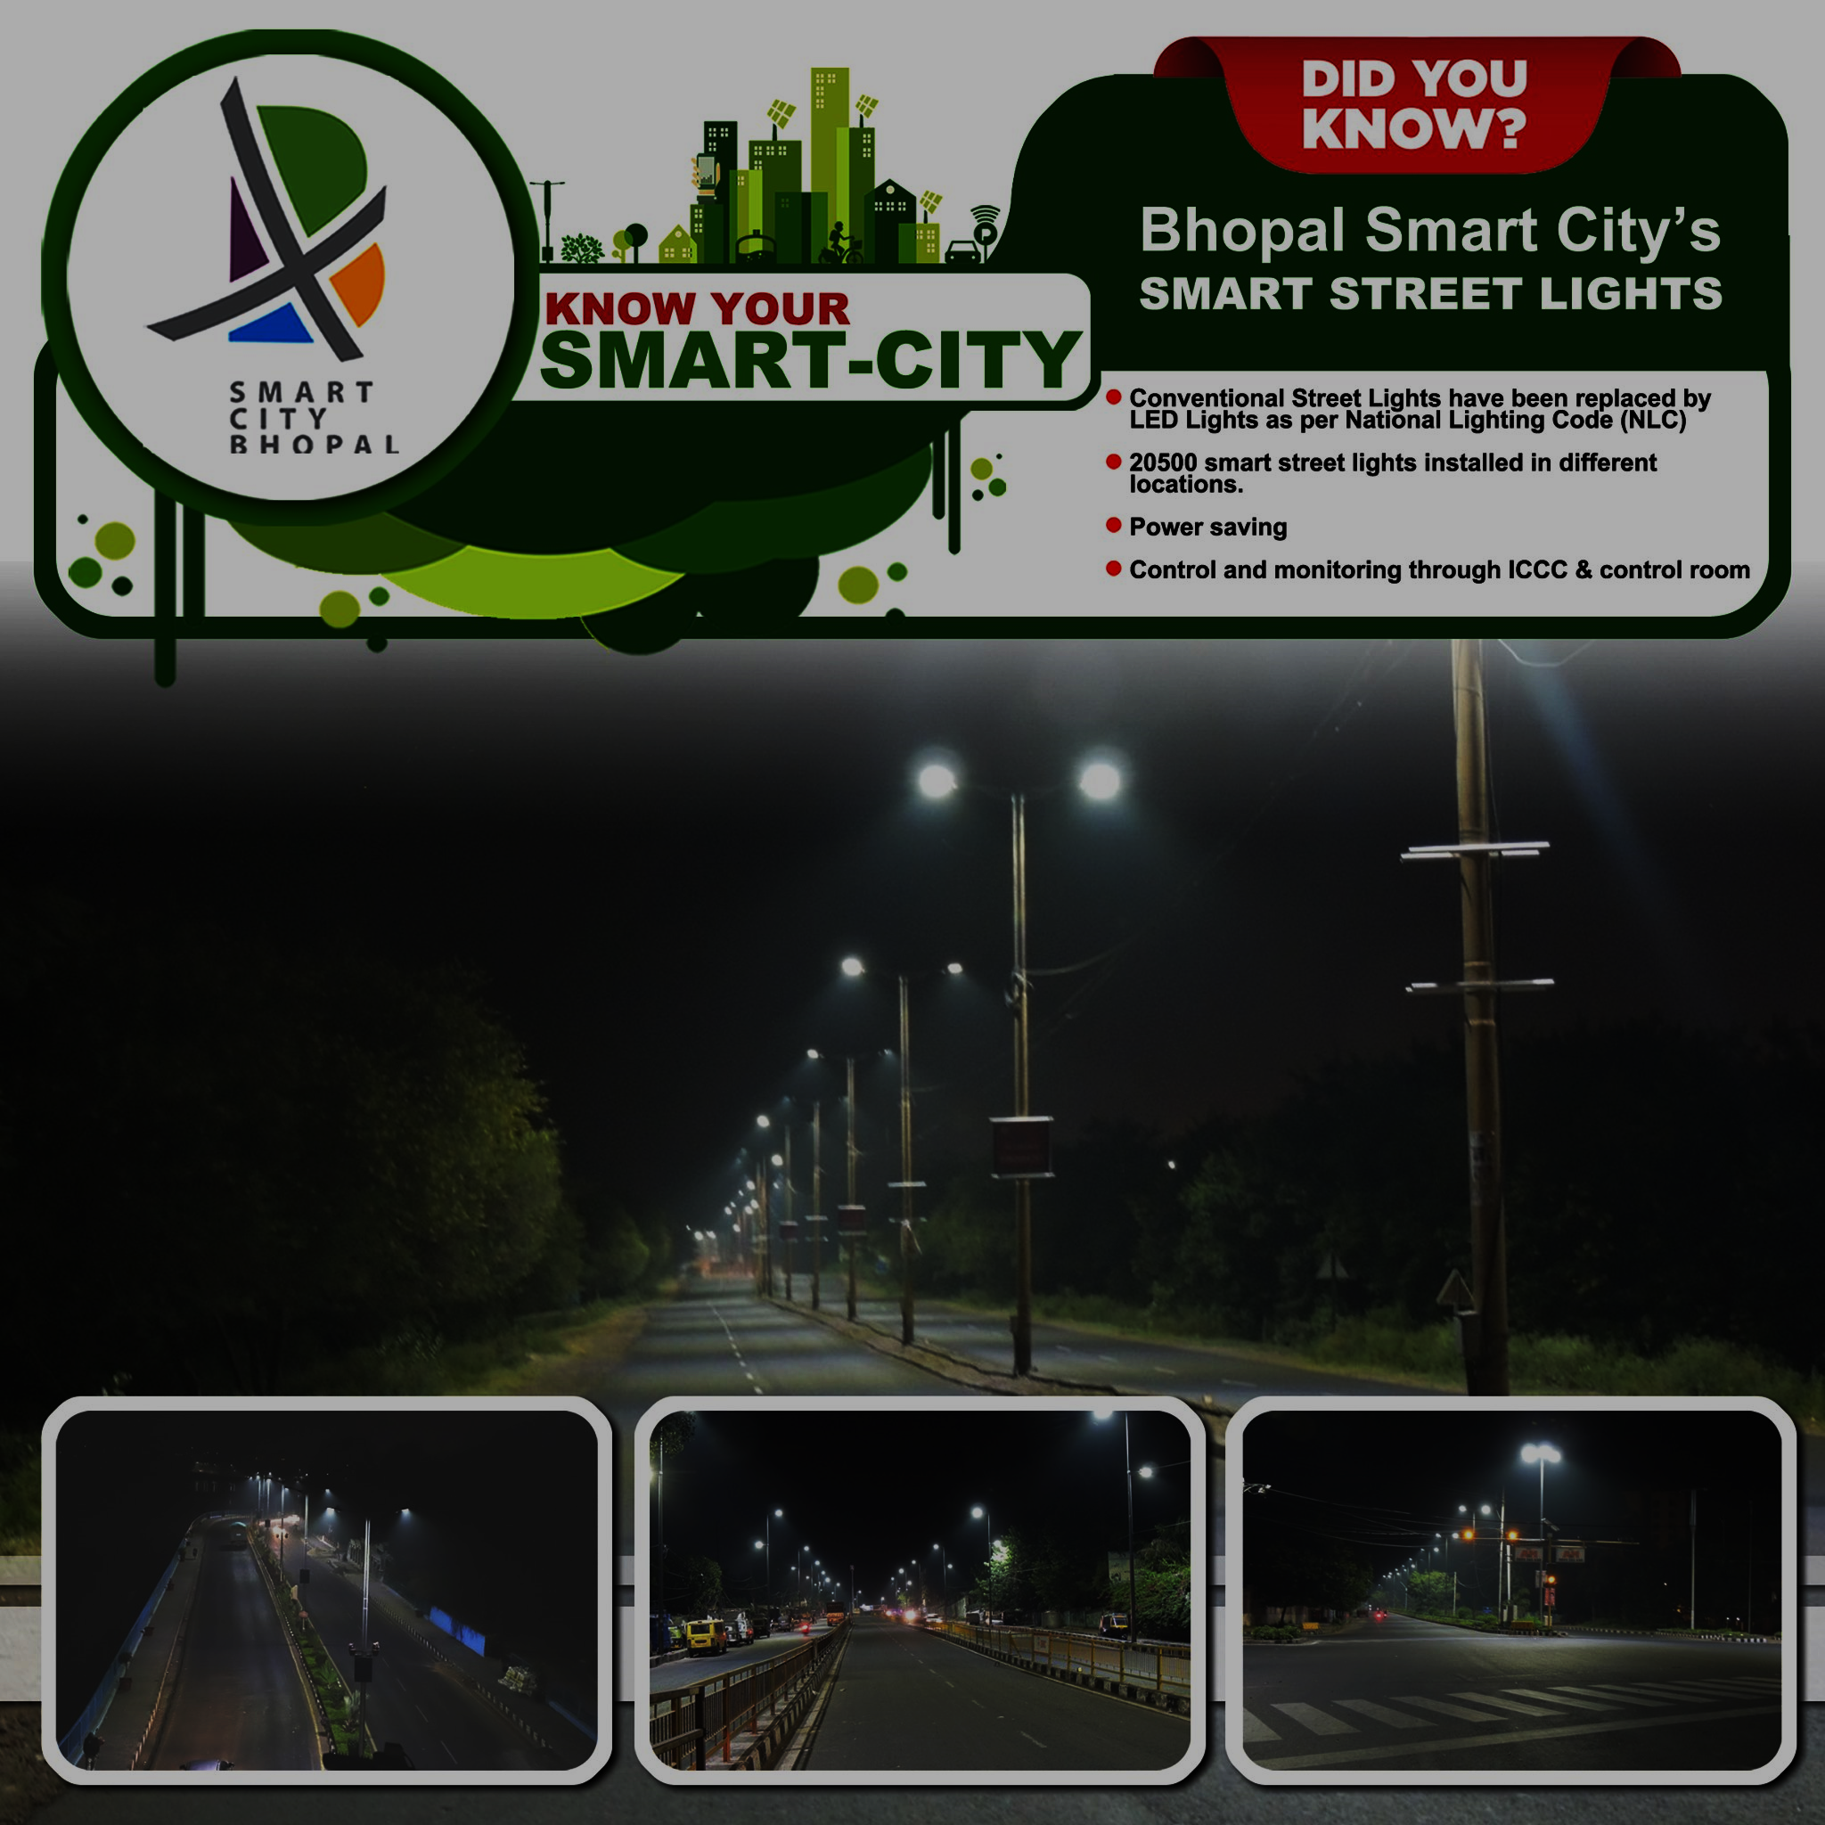
Street Light Automation in Bhopal City
Street light automation in Bhopal city #Gov.of Madhya Pradesh have signed an agreement for the installation of 40,000 energy efficient LED streetlights at various locations in Bhopal.
The smart LED streetlights will help enable savings of around 1.3 crore units per year. It will also result in monetary savings of around 8.5 crore per annum.
Govt of Madhya to replace 40,000 conventional streetlights with energy efficient LED streetlights. This initiative will help brighten Bhopal with multitude of benefits such as energy savings, safer streets, and monetary savings.

Slide 14


Slide 15

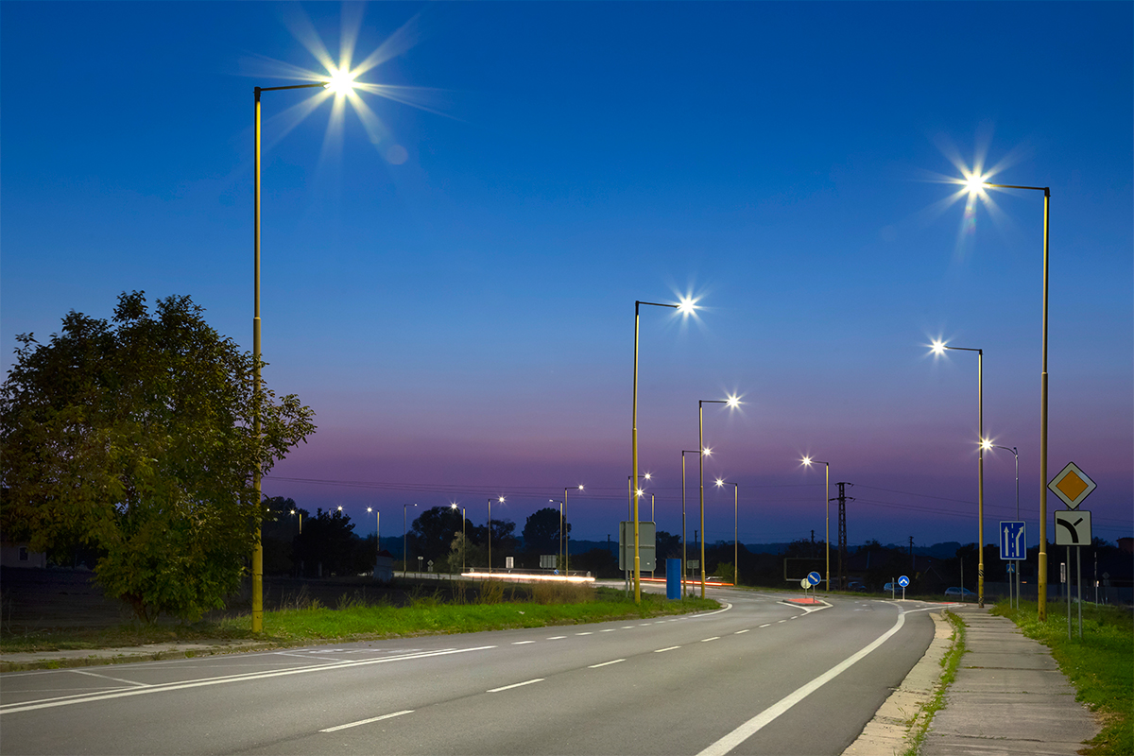
-:Thanking you :-

